Slide 1
Winning Marketing Strategies for Launching a New Sports Drink
Effective tactics for promoting a refreshing beverage
Notes:
AI-generated content may be incorrect. --- Launching a new sports drink requires a well-planned marketing strategy to ensure its success. This presentation will cover essential strategies tailored for the sports beverage market, from initial analysis to post-launch tactics.

Slide 2
Agenda for Discussion
Marketing Strategy for a Sports Drink Product Launch
Post-Launch Marketing Strategies for a New Sports Drink
Notes:
We will begin with effective marketing strategies for launching a new sports drink, including market analysis and identifying the target audience. Following that, we'll explore post-launch marketing strategies to maintain momentum and customer engagement.

Slide 3
Marketing Strategy for a Sports Drink Product Launch
Notes:
Creating a successful marketing strategy involves understanding the market dynamics and identifying your target customers. This section will guide you through the necessary steps to ensure a strategic launch.

Slide 4

Market Analysis and Target Audience
Importance of Market Analysis
Conducting thorough market analysis is essential to identify the target audience for the new sports drink, ensuring effective marketing strategies.
Understanding Consumer Preferences
Understanding consumer preferences helps tailor the sports drink to meet the specific needs and desires of the target audience.
Trends in Sports Nutrition
Identifying trends in sports nutrition allows for the development of a product that aligns with current market demands and consumer interests.
Analyzing Competitors
Analyzing potential competitors in the market helps in positioning the new sports drink effectively and identifying unique selling points.
Notes:
--- Conducting thorough market analysis is crucial to identify the target audience for the new sports drink. This involves understanding consumer preferences, trends in sports nutrition, and potential competitors in the market. Image source: Microsoft 365 content library

Slide 5
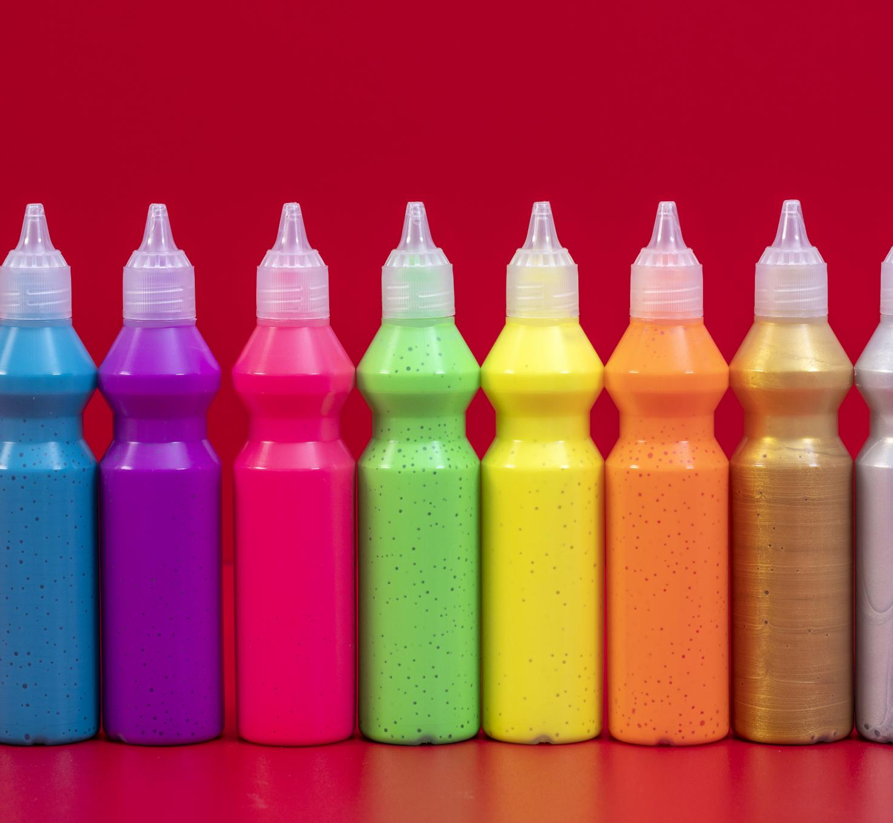
Product Positioning and Unique Selling Proposition (USP)
Differentiation from Competitors
Clearly define how your sports drink stands out in the market. Highlight aspects such as unique formulations or innovative packaging.
Highlighting Key Benefits
Emphasize specific benefits like natural ingredients and enhanced hydration efficiency that resonate with health-conscious consumers.
Appealing Flavors and Options
Showcase a variety of flavors that cater to diverse taste preferences, making your product more appealing to consumers.
Notes:
--- Defining how your sports drink is different from competitors is key. Establish a unique selling proposition that highlights the specific benefits, such as ingredients, flavors, or hydration efficiency, that will attract your target audience. Image source: Microsoft 365 content library

Slide 6

Marketing Channels and Tactics
Effective Channel Selection
Choosing the right channels is crucial for effectively reaching your target audience and boosting engagement.
Social Media Marketing
Utilizing social media platforms can enhance visibility and foster direct engagement with your audience.
Influencer Partnerships
Collaborating with influencers helps to leverage their audience and credibility, boosting brand recognition.
Sponsoring Sports Events
Participating in or sponsoring sports events can significantly increase brand visibility and connect with potential customers.
Notes:
--- Selecting the right marketing channels is essential for reaching your audience effectively. Consider using social media, influencer partnerships, and sports events to maximize visibility and engagement for your sports drink. Image source: Microsoft 365 content library

Slide 7
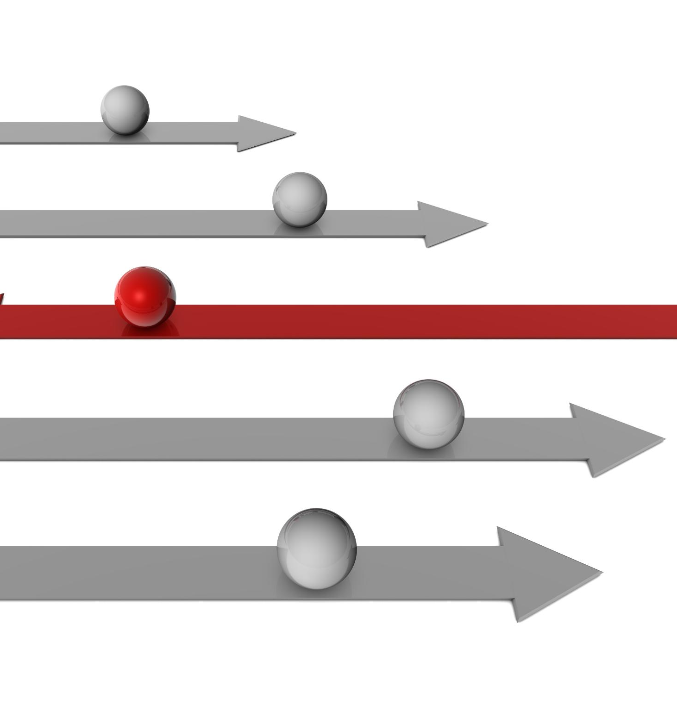
Launch Timeline and Key Milestones
Importance of a Timeline
A well-structured timeline is essential for tracking progress and ensuring timely execution of critical actions.
Key Milestones Overview
Identifying key milestones helps in outlining crucial steps from product development to marketing strategies.
Product Development Phases
From ideation to launch, each phase of product development must be carefully planned and executed.
Notes:
--- A well-structured timeline helps track progress and ensure all critical actions are executed on schedule. Outline key milestones, from product development to marketing campaigns, that will lead up to the launch. Image source: Microsoft 365 content library

Slide 8

Performance Metrics and Evaluation
Importance of Metrics
Establishing performance metrics is crucial for measuring the effectiveness of any launch strategy.
Key Performance Indicators
Focus on key indicators like sales figures, customer feedback, and brand awareness to assess success.
Evaluating Success
Use these metrics to evaluate the overall success of the launch strategy and make necessary adjustments.
Notes:
--- Establishing performance metrics is vital to measure the effectiveness of the launch strategy. Focus on key indicators such as sales figures, customer feedback, and brand awareness to evaluate success. Image source: Microsoft 365 content library

Slide 9
Post-Launch Marketing Strategies for a New Sports Drink
Notes:
After the initial launch, it is essential to maintain momentum with effective post-launch marketing strategies that enhance customer engagement and brand loyalty.

Slide 10
Continuous Market Analysis and Feedback
Market Trend Analysis
Continuously analyze market trends to understand changing consumer behaviors and preferences effectively.
Gathering Customer Feedback
Collect customer feedback regularly to gain insights into product performance and areas for improvement.
Refining Strategies
Use the data collected to refine marketing strategies and enhance product offerings to meet consumer needs effectively.
Notes:
--- Post-launch, continue to analyze market trends and gather customer feedback. This ongoing analysis helps refine marketing strategies and product offerings to better meet consumer needs. Image source: Microsoft 365 content library

Slide 11
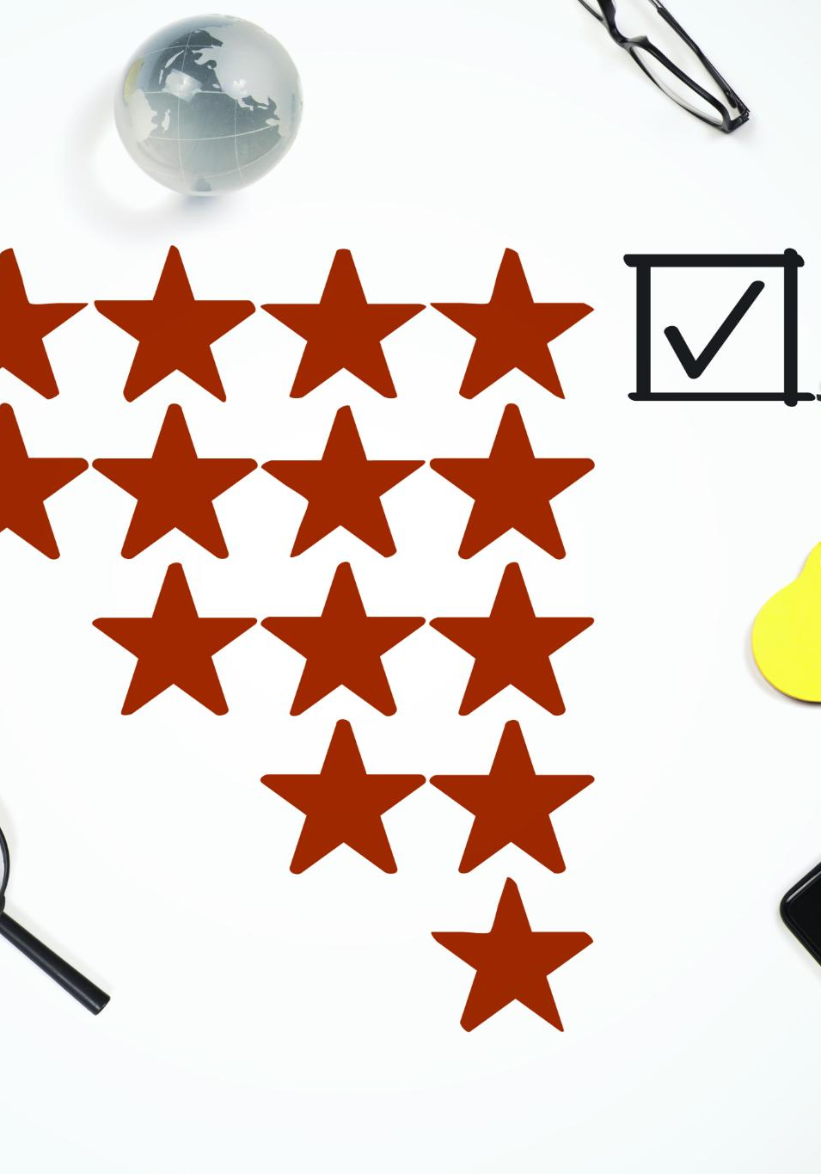
Gathering Customer Feedback
Conduct Surveys and Focus Groups
Surveys and focus groups help understand customer preferences and expectations for our sports drink. This initial step is crucial.
Utilize Social Media and Reviews
Gather real-time feedback from a broader audience using social media and online reviews to get diverse customer insights.
Analyze Data for Trends
Analyze gathered data to identify trends and areas for improvement ensuring our product aligns with market demands.
Notes:
Customer feedback is essential for our sports drink launch. First, conduct surveys and focus groups to understand customer preferences and expectations. Second, use social media and online reviews to gather real-time feedback from a broader audience. Lastly, analyze the data to identify trends and areas for improvement, ensuring our product meets market demands.

Slide 12
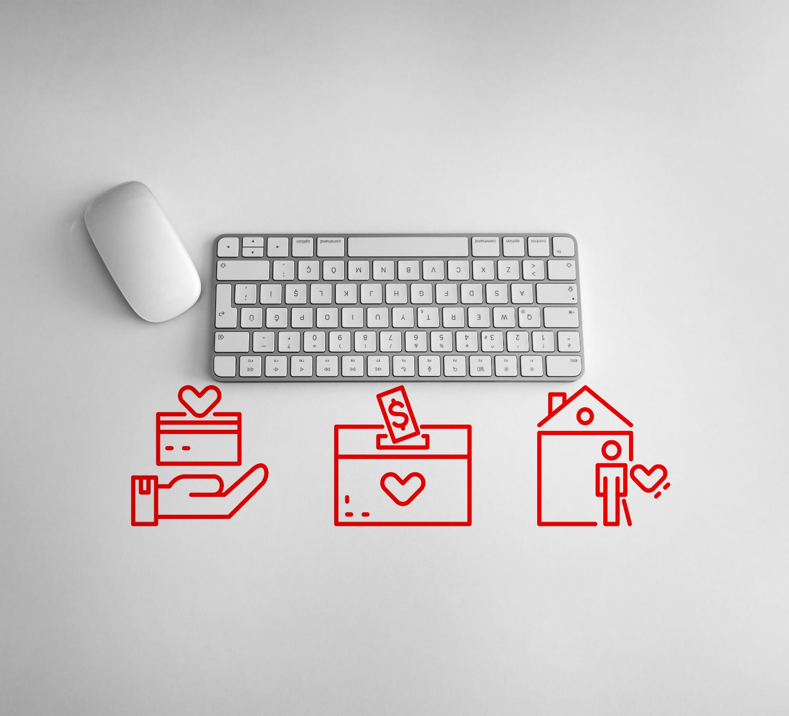
Customer Retention and Loyalty Programs
Loyalty Programs
Loyalty programs incentivize repeat purchases by rewarding customers, ultimately increasing brand loyalty.
Subscription Models
Subscription models provide convenience and value, leading to higher customer retention and consistent revenue.
Engagement Strategies
Continuous engagement with customers through personalized communication strengthens their connection to the brand.
Notes:
--- Implementing customer retention strategies, such as loyalty programs or subscription models, will foster brand loyalty and encourage repeat purchases. Engaging with customers continuously strengthens brand connection. Image source: Microsoft 365 content library

Slide 13
Post-Launch Digital Marketing Tactics
Email Campaigns
Email campaigns are a direct way to engage customers post-launch, allowing for personalized communication and updates.
Targeted Ads
Targeted ads help reach specific audiences based on their interests and behaviors, maximizing marketing effectiveness.
Social Media Promotions
Social media promotions can boost brand visibility and customer engagement through interactive content and community building.
Notes:
--- Utilizing digital marketing tactics, such as email campaigns, targeted ads, and social media promotions, can effectively reach customers and maintain engagement after the launch. Focus on creating compelling content that resonates with your audience. Image source: Microsoft 365 content library

Slide 14
Conclusion
Strategic Market Understanding
Understanding the market is crucial for launching a new sports drink. It helps in identifying customer needs and preferences.
Effective Marketing Strategies
Implementing effective marketing strategies is essential for a successful product launch. This includes promotions, branding, and advertising.
Post-Launch Engagement
Post-launch engagement with customers is vital for building lasting relationships. It ensures customer loyalty and ongoing feedback.
Notes:
Launching a new sports drink involves a strategic approach, from understanding the market to post-launch engagement. By implementing these marketing strategies, you can ensure a successful product launch and foster lasting customer relationships.

